Slide 1


Introduction to .NET MAUI
<Name>
<Title>
@<Twitter>
/<YouTube>

Slide 2
Agenda
Introduction to .NET MAUI
Building our First App
MVVM & Data Binding
Navigation
Accessing Platform Functionality
Displaying Data
App Themes

Slide 3
Machine Setup

Slide 4
Code & Walkthrough aka.ms/maui-workshop

Slide 5









Build anything with a unified platform
.NET
Cloud
Web
Desktop
Mobile
Gaming
IoT
AI
+
+
Visual Studio
Visual Studio Code
CLI
Linux
NuGet
GitHub
Components, tools, library vendors
Windows
macOS
Tools
Operating system
Ecosystem

Slide 6









Notes:
Traditionally, to target all of these different platforms, you need a bunch of different teams <CLICK>

Slide 7








Swift
Swift
JS
JS
iOS
iOS
JS
Swift
JS
JS
Swift
JS
JS
Java
.NET
JS
Java
C++
Java
C++
JS
Obj-C
Kotlin
Obj-C
Java
Obj-C
macOS
Kotlin
Kotlin
Obj-C
Kotlin
Notes:
And all those teams have different skill sets. But wouldn’t it be amazing if instead of having C++, Java, Kotlin, Swift, JS devs – you could just have one type? <CLICK>

Slide 8
iOS
iOS
macOS
.NET
.NET
.NET
.NET
.NET
.NET
.NET
.NET
.NET
.NET
.NET
.NET
.NET
.NET
.NET
.NET
.NET
.NET
.NET
.NET
.NET
.NET
.NET
.NET
.NET
.NET
.NET
.NET
.NET
.NET
.NET
.NET
.NET
.NET
.NET
.NET
.NET
.NET
.NET
.NET
.NET
.NET
.NET
.NET
.NET
Notes:
Such as .NET – which you probably already have SOMEWHERE, or someone has experience with it

Slide 9

Notes:
That’s what .NET MAUI is for!

Slide 10
An open-source app platform
from Microsoft for building
modern, performant, & multi-platform
iOS, Android, macOS, & Windows apps
with C# and .NET from a
single shared codebase.

Slide 11

.NET Multi-platform App UI (MAUI)
Single project system, single codebase
macOS
iOS
WinUI
Mac Catalyst
iOS
Android

Slide 12

.NET MAUI App Architecture
C#
C#
C#
C#
Shared Code
UI, Resources, Platform Features, & Business Logic

Slide 13




Productive environment
Maximize code reuse
Native performance & integrations
Expansive ecosystem

Slide 14


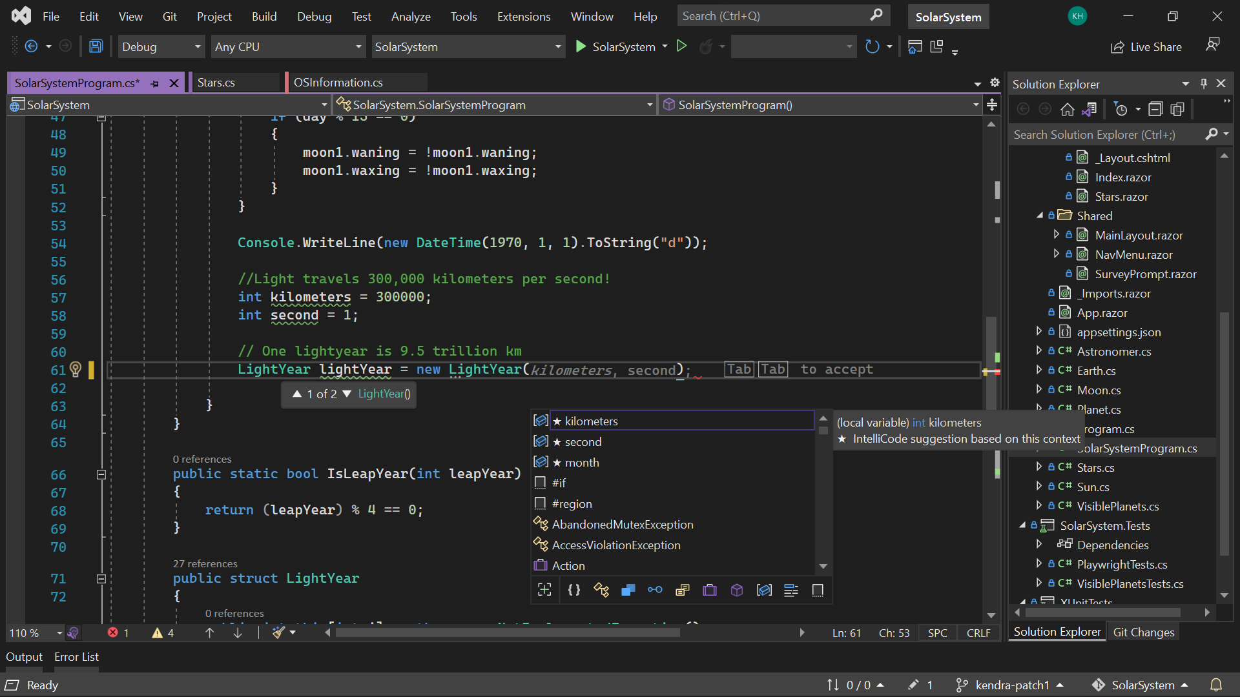
Visual Studio 2022
Modern development
Build innovative, modern apps using .NET 6, GitHub and Azure with integrated tooling
Personal and team productivity
Live Share, Hot reload everywhere, Web live preview, IntelliCode, enhanced debugging and testing tools
Scale to projects of any size
An optimized, modern UI built on 64-bit architecture to support the largest, most complex codebases and workflows
VisualStudio.com/download

Slide 15

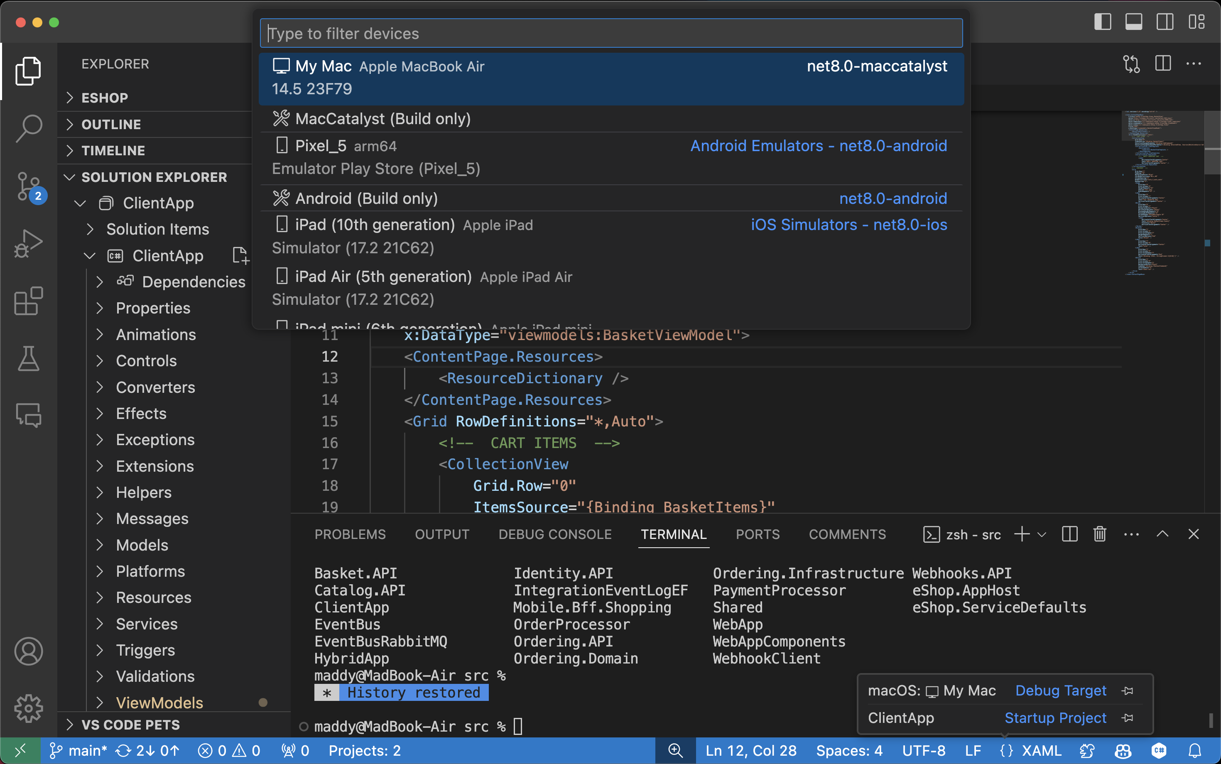
Visual Studio Code
Flexible & Lightweight
Supercharged editing experience that is completely customizable for you. Add extensions, change styles, and tweak for your needs easily.
Runs anywhere
Works and looks the same on macOS, Windows, and Linux, and even on the web with Codespaces. Your settings and extensions sync everwhere.
Support for .NET
Build for the web, cloud, and mobile. Add C# Dev Kit and .NET MAUI extensions for even more powerful tools including Solution Explorer and Hot Reload.
https://code.visualstudio.com

Slide 16
Cross-Platform UI

Slide 17




UIActivityIndicator
ProgressBar
UISlider
SeekBar
ActivityIndicator
Slider

Slide 18
Controls
CarouselView
CollectionView
ListView
Picker
TableView
IndicatorView
ProgressBar
ActivityIndicator
Editor
Entry
CheckBox
DatePicker
Slider
Stepper
Switch
TimePicker
Button
ImageButton
RadioButton
RefreshView
SearchBar
SwipeView
BlazorWebview
Border
BoxView
Frame
GraphicsView
Image
Label
ScrollView

Slide 19

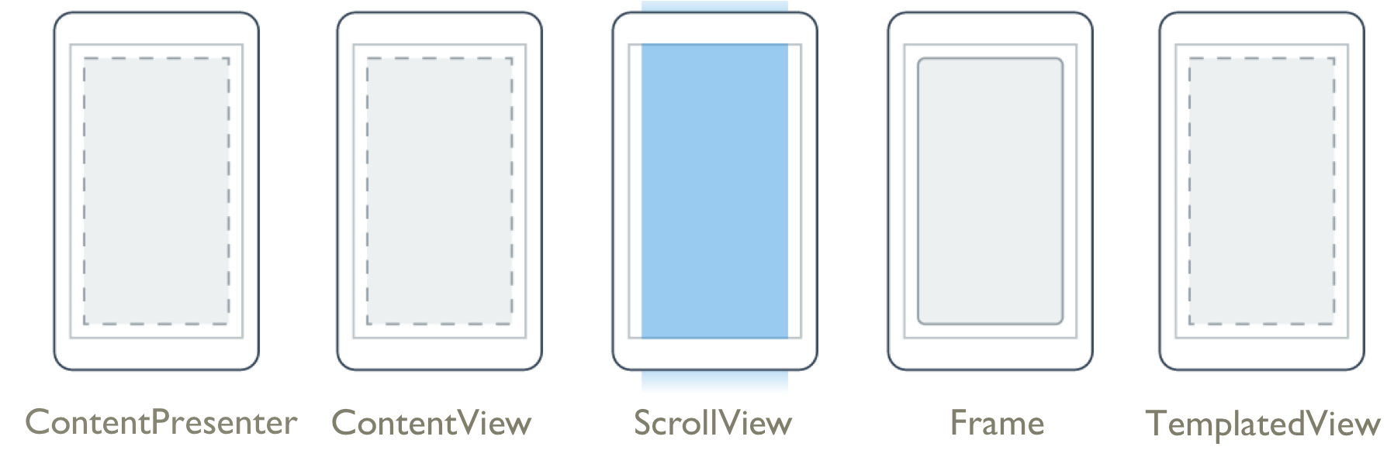
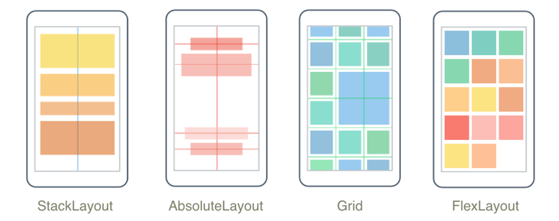
Layouts
Pages
Content
Flyout
Navigation
Tabbed

Slide 20
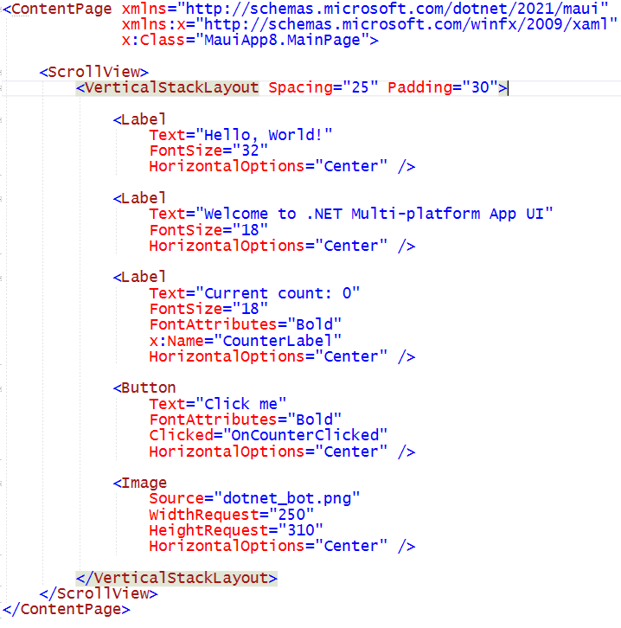
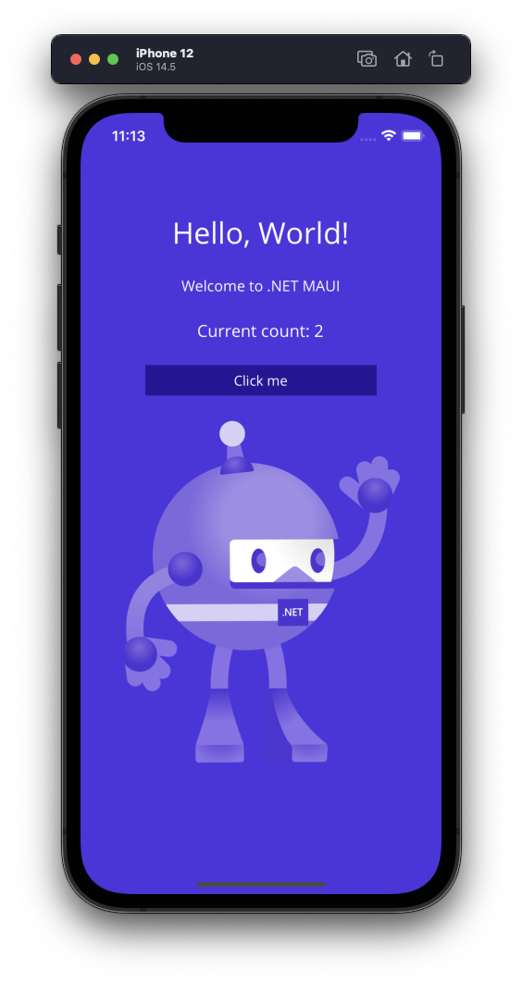
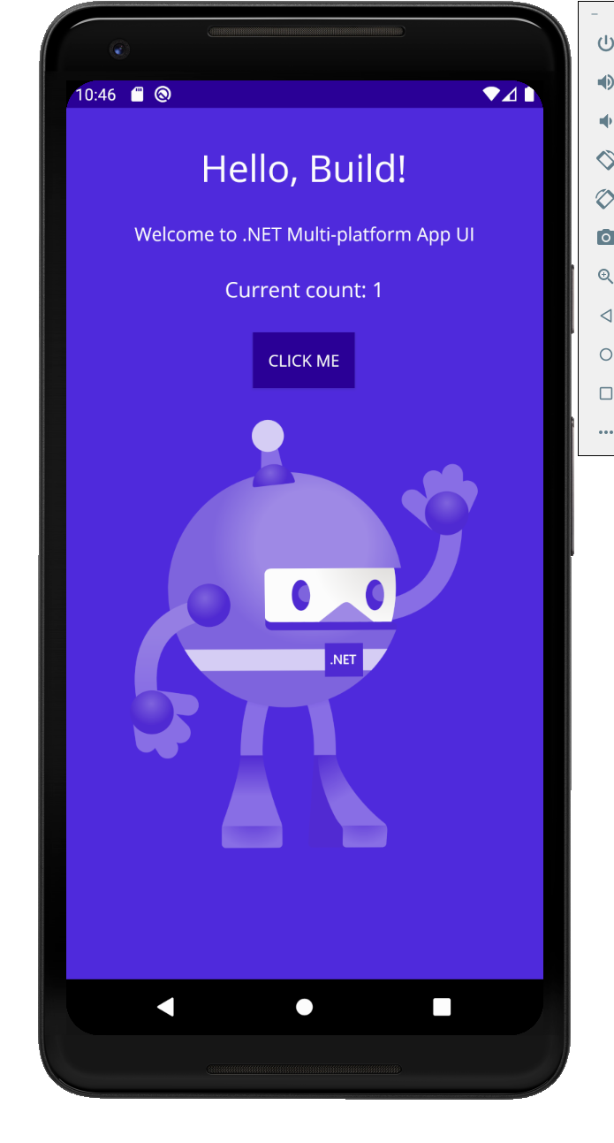
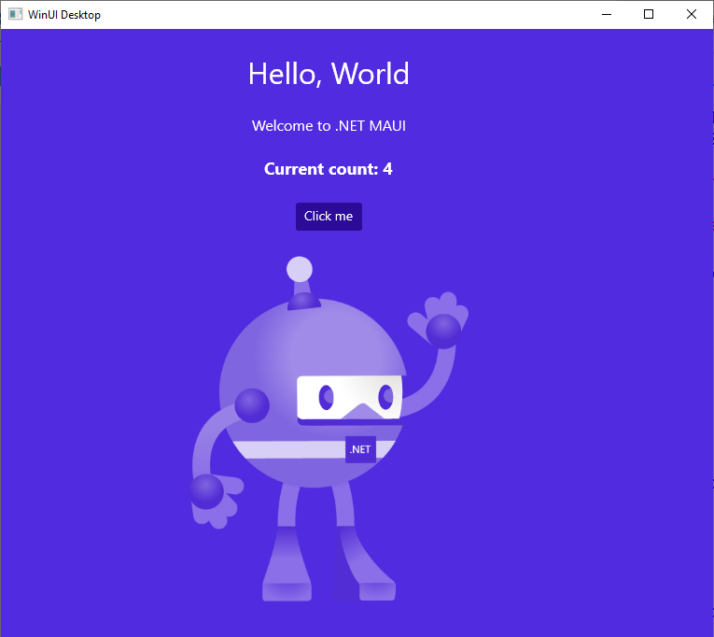
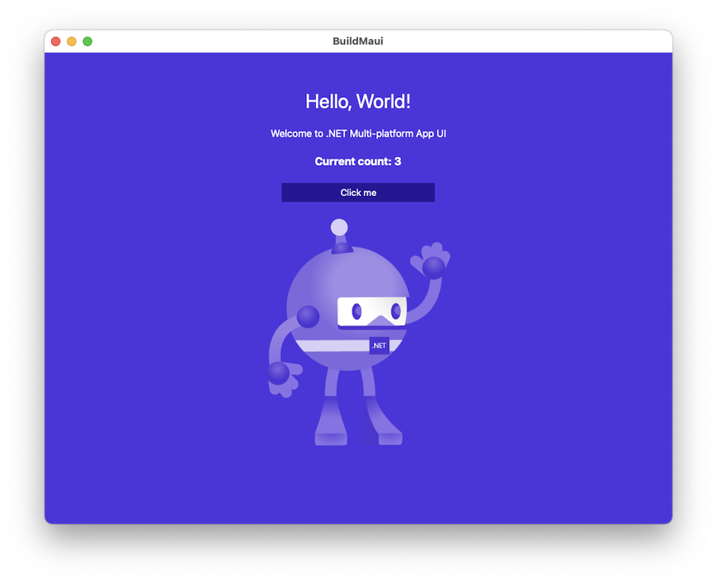

Slide 21
Platform API Access

Slide 22
iOS
MapKit
UIKit
SiriKit
ARKit
CoreML
System.Net
System
System.IO
System.Linq
System.Xml
System.Data
System.Windows
System.Numerics
System.Core
System.ServiceModel
C#

Slide 23
Android
Fingerprint
Bluetooth
Picture-in-Picture
Geolocation
NFC
System.Net
System
System.IO
System.Linq
System.Xml
System.Data
System.Windows
System.Numerics
System.Core
System.ServiceModel
C#

Slide 24

Cross-Platform APIs
Sms
Secure Settings
Preferences
Flashlight
Clipboard
Gyroscope
Magnetometer
Geolocation
Phone Dialer
Device Display Info
Email
Device Info
Battery
Compass
Accelerometer
Screen Lock
Data Transfer
Text to Speech
Geocoding
File System
Connectivity
Vibration

Slide 25
Geolocation Example
// Get cached location, else get real location.
var location = await Geolocation.GetLastKnownLocationAsync();
if (location == null)
{
location = await Geolocation.GetLocationAsync(new GeolocationRequest
{
DesiredAccuracy = GeolocationAccuracy.Medium,
Timeout = TimeSpan.FromSeconds(30)
});
}

Slide 26
Geolocation Example
// Register service
builder.Services.AddSingleton<IGeolocation>(Geolocation.Default);
// Inject service
IGeolocation geolocation;
public MyViewModel(IGeolocation geolocation)
{
this.geolocation = geolocation;
}

Slide 27
Performance

Slide 28
Built on trusted technology
ARM BINARY
IL + JIT
.NET
.NET
AOT
.APP
Compile and Link
.APK .AAB
C#
C#
Runs natively
Runs natively
Bindings
Bindings
.NET for iOS does full Ahead Of Time (AOT) compilation to produce an ARM binary for Apple’s App Store.
.NET for Android takes advantage of Just In Time (JIT) & Ahead of Time (AOT) compilation on the Android device.

Slide 29
Full App Platform
✓ 40+ Pages, layouts, and controls
(Build from C# or XAML)
✓ Two-way data binding
✓ Navigation
✓ Visual State Manager
✓ Animation API
✓ Dependency Service
✓ Messaging Center
✓ CI/CD Support
✓ Hybrid Development with Blazor
✓ Platform API Access
✓ Images, Icons, Fonts, Splash Screens
✓ Custom & Default Themes
C#
C#
C#
C#
Shared Code
UI, Resources, Platform Features, & Business Logic

Slide 30

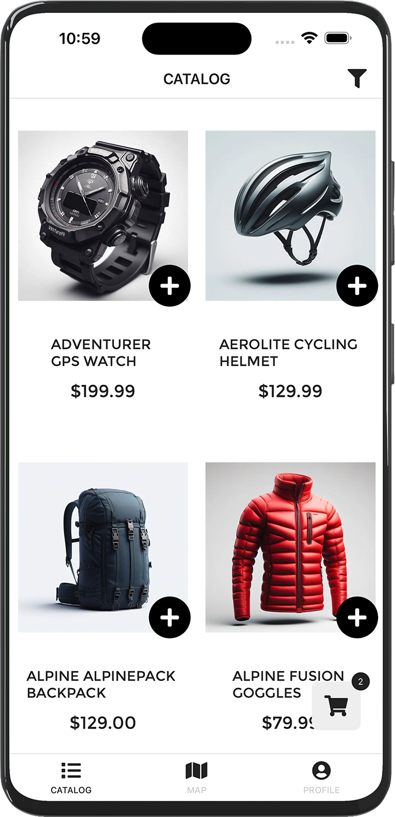
eShop Architecture Sample
github.com/dotnet/eshop

Slide 31











eShop reference application
Cloud Services
Aspire Orchestration
Client Apps
Identity Service
Mobile BFF
Identity API
PostgreSQL
Mobile App
OpenAI
Mobile API
Catalog Service
Catalog API
PostgreSQL
Order Service
Ordering API
Web App
Ordering API
Order Processor
PostgreSQL
Event Bus
Browser
Blazor App
Basket Service
Basket API
Redis
Payment Service
Payment Processor
Admin Services
Webhook Client
Webhooks Service
Observability
Webhooks API
PostgreSQL

Slide 32
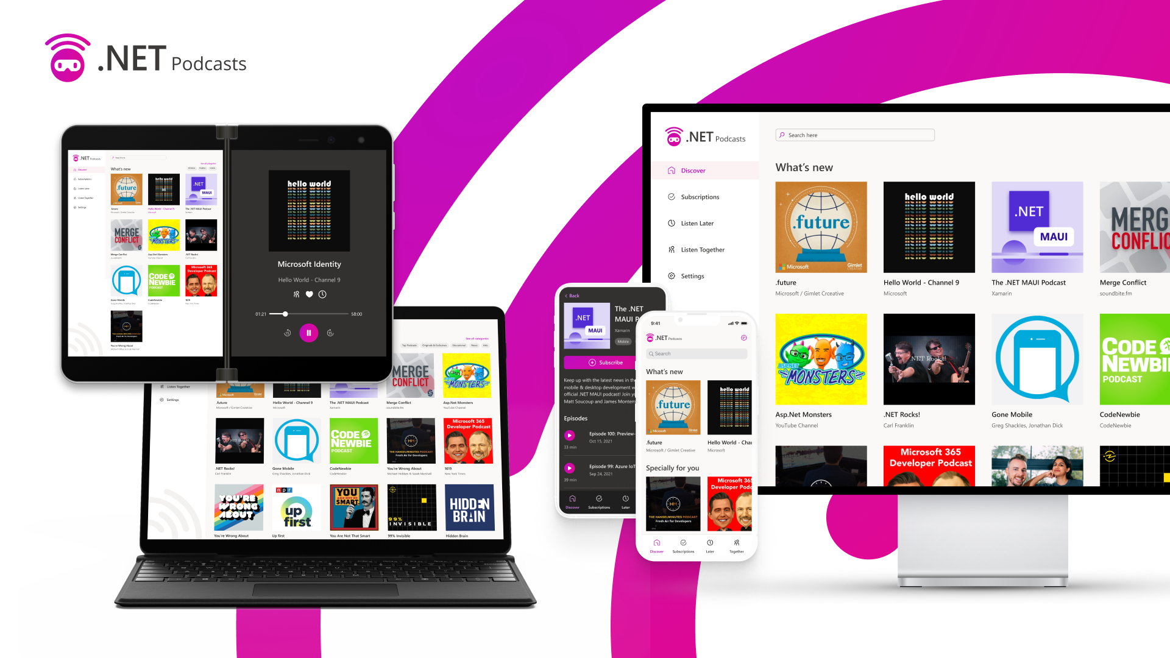

Slide 33
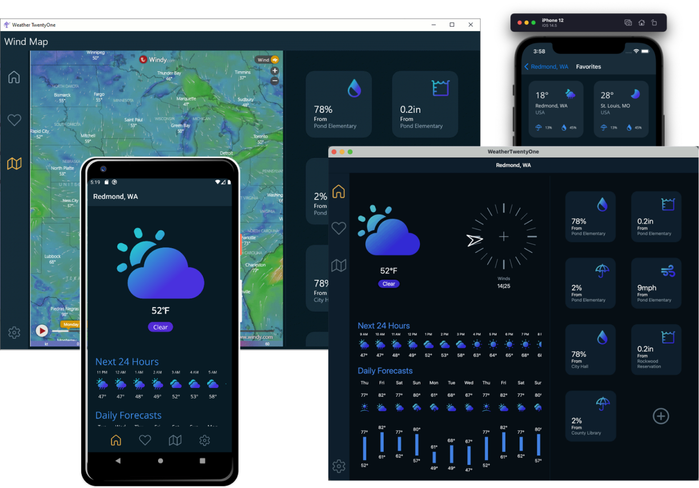

Slide 34



























Notes:
[DAVE] Not only are we active on github but we have lots of great customers using MAUI already to build their apps

Slide 35
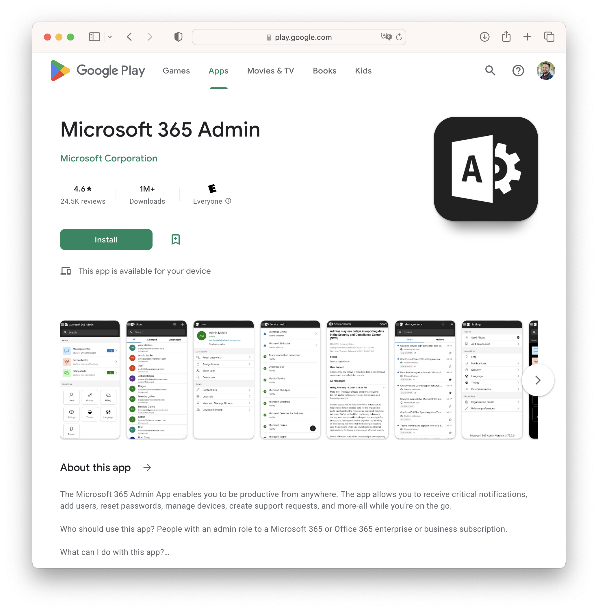
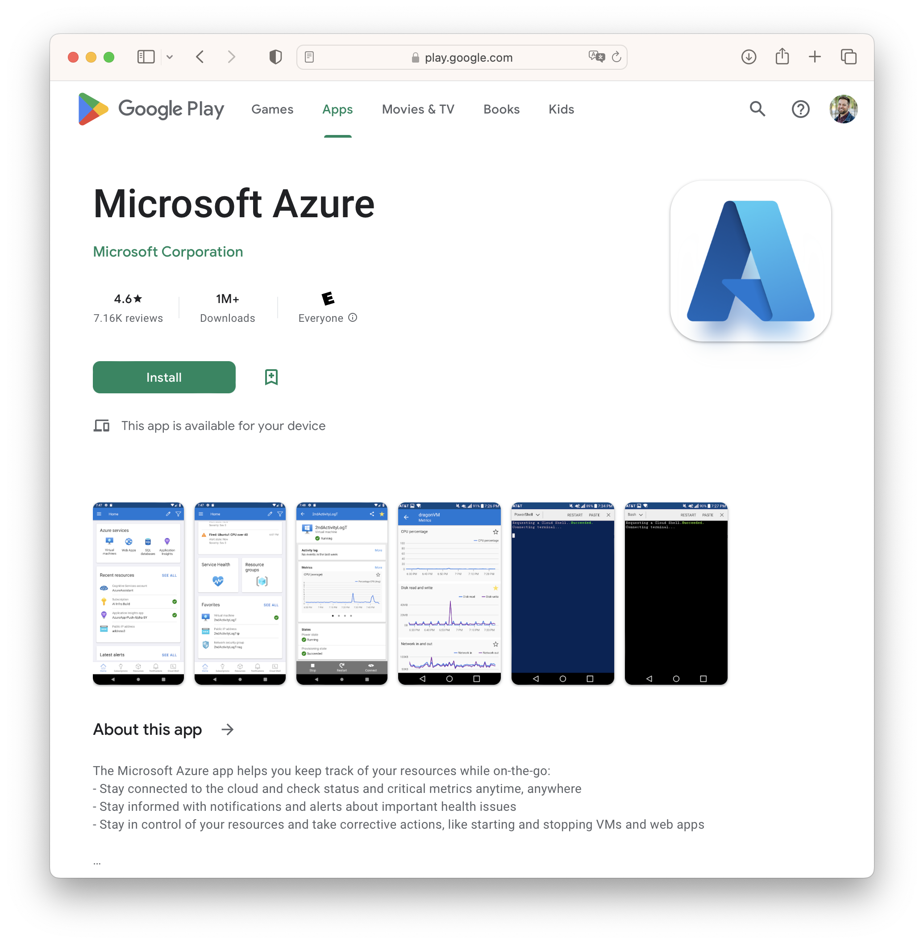
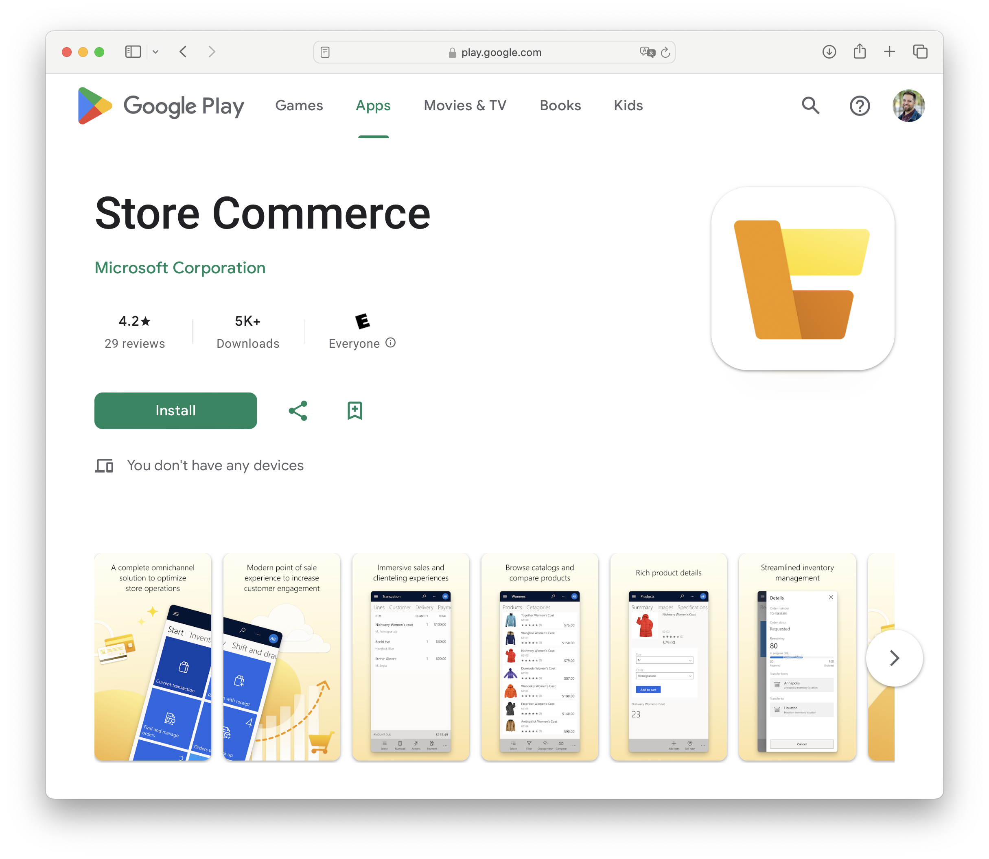
.NET MAUI at Microsoft
Notes:
[DAVE] And one question we hear a lot – yes Microsoft uses it

Slide 36

























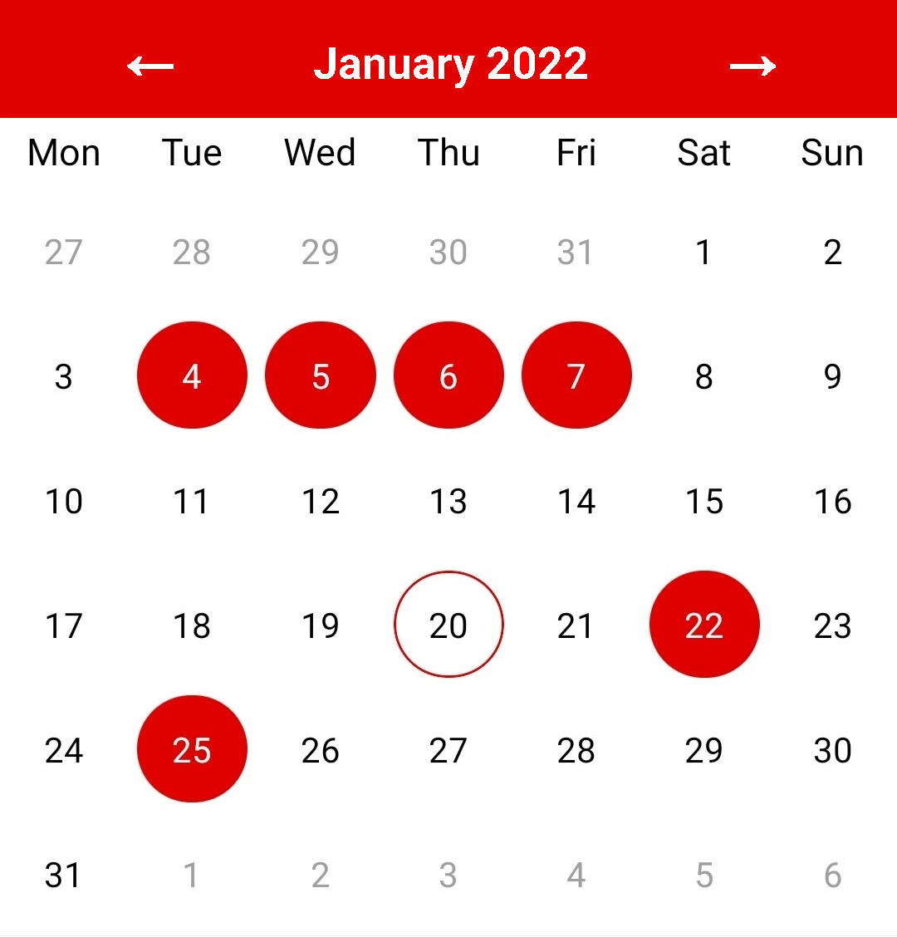



























Notes:
Acceso App - Origin - DEV Community 👩‍💻👨‍💻

Slide 37
What about web developers?

Slide 38








Web development with .NET
ASP.NET Core
Blazor
JS

Slide 39



Blazor is flexible. You have choices.
Blazor Server
Blazor WebAssembly
Blazor
Blazor
DOM
SignalR
.NET
Razor Components
DOM
.NET
Razor Components
WebAssembly

Slide 40






Blazor

Slide 41



Blazor Hybrid:
+

Slide 42
Hybrid Architecture - .NET MAUI & Blazor
C#
C#
C#
C#
C#
Shared Blazor Components
Shared Business Logic

Slide 43


Blazor hybrid apps
Native app container & embedded controls
Fully native web UI through platform WebView
Multi-platform with MAUI abstractions
No internet required
Store distribution and reach
Blazor
Razor Components
BlazorWebView
.NET MAUI
Native APIs
WinUI
Mac
Catalyst
iOS
Android
macOS
iOS
Notes:
[MADDY] We’ve seen lots of people adopting blazor hybrid, so we’ve continued to work with our friends over there to refine the experience

Slide 44
Hybrid app benefits
Reuse existing web development skills and code
Access to all the native platform capabilities of the device
Mix native & web UI
Reduce app development time
Ship seamlessly to app store or internal distribution

Slide 45

.NET offers choice for developers
BLAZOR
C#, HTML, CSS
BLAZOR + .NET MAUI
.NET MAUI
C#, XAML
Reach
Depth
Websites and PWAs
Hybrid
Native
Notes:
[MADDY] Performance is fun and all but we also worked on some areas you told us to focus on – namely hybrid and desktop app functionality!

Slide 47
Build anything with a unified platform
.NET
Cloud
Web
Desktop
Mobile
Gaming
IoT
AI
+
+
Visual Studio
Visual Studio Code
CLI
Linux
NuGet
GitHub
Components, tools, library vendors
Windows
macOS
Tools
Operating system
Ecosystem

Slide 48
Q&A
<Name>
<Title>
<email>
<website>
@<twitter>
/<YouTube>

